Slide 1

Predictive Analysis for IPL Cricket Scores
Under the guidance of
Dr.T.Prem Jacob, M.E., Ph.D.,
by
Vishwanth G (41111386)
Vikraman S (41111371)

Slide 2
Presentation Outline
Introduction
Abstract
Literature survey
Inferences from Literature Survey
Objectives
System Architecture
Workflow Snap
Description of Software for Implementation
References

Slide 3
Introduction
In recent years, the Indian Premier League (IPL) has become a fertile ground for the application of advanced analytics and machine learning (ML) techniques. Predicting the score in IPL matches is a complex problem that involves analysing various factors such as batting and bowling performances, player statistics, and historical match data.
The primary objective is to develop robust ML models capable of predicting the total runs a team is likely to score based on various input variables such as batting team, bowling team, runs scored, wickets taken, overs played, and performance in the last five overs.
This endeavours involves pre-processing the data to handle categorical variables, training multiple regression models including Random Forest, Gradient Boosting, and Linear Regression, and ultimately aggregating their predictions to achieve enhanced accuracy and reliability.

Slide 4
Abstract
This project explores the application of machine learning (ML) techniques to predict scores in Indian Premier League (IPL) cricket matches. We pre-process the data to encode categorical variables and train multiple regression models including Random Forest, Gradient Boosting, and Linear Regression. The models are integrated to aggregate predictions, leveraging features such as batting team, bowling team, runs, wickets, overs, and recent performance trends. Our approach aims to enhance predictive accuracy by capturing the complex interplay of factors influencing match outcomes in dynamic cricket settings. The outcomes not only facilitate informed decision-making for teams and analysts but also deepen understanding of game dynamics and contribute to the evolving field of sports analytics. This project underscores the transformative potential of ML in advancing predictive capabilities and strategic insights.

Slide 5
Literature Review
AUTHOR | YEAR OF PUBLICATION | DESCRIPTIONS | PROS | CONS
Devanbu et al. | 2018 | This study applies machine learning algorithms to predict cricket scores based on historical match data, including player performance and match conditions. | Demonstrates the efficacy of machine learning in capturing complex patterns in cricket data, leading to accurate score predictions. | Limited discussion on the impact of external factors
Kumar et al. | 2020 | This research focuses on using ensemble learning techniques to predict cricket scores, integrating multiple regression models and data preprocessing strategies to enhance prediction accuracy. | Offers a comprehensive approach to model aggregation. | Limited discussion on the generalizability across different cricket formats and match conditions.

Slide 6
Literature Review
AUTHOR | YEAR OF PUBLICATION | DESCRIPTIONS | PROS | CONS
Patel and Desai | 2017 | Investigates the application of deep learning architectures, particularly Recurrent Neural Networks (RNNs), for time-series prediction of cricket scores. | Demonstrates the potential of RNNs in handling sequential cricket data, such as batting order and over-by-over performance. | Challenges include model complexity, training time, and the need for extensive data preprocessing
Sharma et al. | 2019 | Explores Bayesian networks for probabilistic score prediction in cricket | Provides a probabilistic framework for score prediction and enabling risk assessment in decision-making processes for cricket teams. | Limited scalability in handling large datasets and real-time prediction scenarios.

Slide 7
Inferences from Literature Survey
Studies have shown that models such as Random Forest, Gradient Boosting, and deep learning architectures like Recurrent Neural Networks (RNNs) can effectively capture complex patterns in player performance, match conditions, and historical data to forecast match outcomes with notable accuracy.
Ensemble methods and Bayesian approaches further enhance predictive reliability by aggregating multiple models and incorporating probabilistic reasoning, respectively.
However, challenges such as model interpretability, computational complexity, and the need for extensive data preprocessing persist across methodologies.
Despite these limitations, the literature underscores the transformative potential of machine learning in advancing predictive analytics in professional cricket.

Slide 8
Objectives
The objectives of this project are to develop and evaluate machine learning models for accurate prediction of cricket scores in IPL matches.
Specifically, the project aims to pre-process and analyse historical match data to train models such as Random Forest, Gradient Boosting, and Linear Regression.
By integrating multiple regression techniques and ensemble learning strategies, the project seeks to enhance predictive accuracy and robustness.
Ultimately, the project aims to provide valuable insights into the application of machine learning in sports analytics, offering practical implications for cricket management, strategy formulation, and fan engagement during IPL tournaments.

Slide 9
System Architecture
Data Acquisition
(Historical data of scores are collected)
Data Preprocessing
(Cleanse the raw data by handling missing values, outliers, and errors)
Model Selection and training
(Choose appropriate statistical models and splitting the data)
Feature Engineering
(Identify and engineer relevant features that can influence scores)
Model Evaluation
(Evaluate model performance using appropriate metrics (e.g., R2,MSE,MAE)
Visualization and Widget
(Developing interactive visualizations and widget to present model predictions and insights)

Slide 10
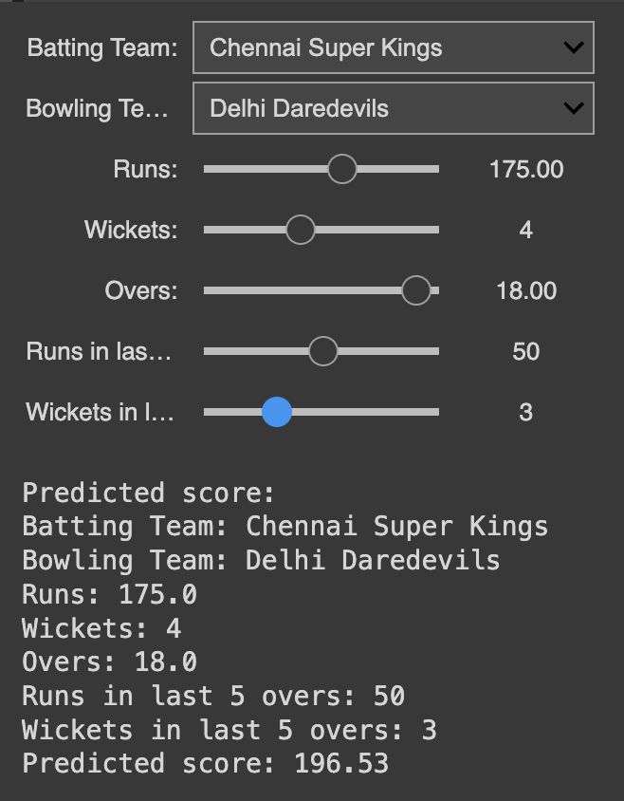
Workflow snap

Slide 11
Description of Software for Implementation
The software implementation for a score prediction project utilizing Google Colab involves leveraging its cloud-based Python environment with integrated GPU support for efficient computation.
Python libraries such as Pandas and NumPy are utilized for data pre-processing and manipulation, Scikit-learn for machine learning models like regression and classification
Matplotlib or Seaborn are employed for visualizing data insights and model results directly within Colab notebooks.
Google Colab's integration with Google Drive allows seamless access to data storage and collaboration, while Git enables version control for collaborative development. This setup ensures flexibility, scalability, and accessibility in developing and deploying predictive models for score analysis.

Slide 12
References
[1] “Ipl Cricket Score and Winning Prediction Using Machine Learning Techniques” Nikhil Dhonge Shraddha Dhole, Nikita Wavre, Mandar Pardakhe, Department of Electrical Engineering, MIT Academy of Engineering (Affiliated to SPPU), Pune, Maharashtra, India Issue: 5 May, 2021.
[2] Lokhande, Chawan, Pramila, “Prediction of Live Cricket Score and Winning,” International Journal of Trend in Research and Development, Volume 5(1), (2018).
[3] I. Anik, S. Yeaser, A. G. M. I. Hossain and A. Chakrabarty, "Player’s Performance Prediction in ODI Cricket Using Machine Learning Algorithms," 2018 4th International Conference on Electrical Engineering and Information & Communication Technology (iCEEiCT).
[4] Omkar Mozar, Soham More, Shubham Nagare and Prof. Nileema Pathak (2022). “Cricket Score and Winning Prediction”

Slide 13
THANK YOU
We thank our guide and panel and all technical and non-technical staff who helped us in achieving this.

